Slide 1


USAC Update for ICA
Clubs/Teams and Race Directors
February 11,, 2024

Slide 2

2024 Race Promoter Meeting Agenda
Introduction Rob Curtis - ICA President
USA Cycling Technical Presentation
Illinois CUP Chad Briggs - ICA At Large
State Championships 2024 Robert Curtis - ICA President
Officials - Clinic, Scheduling, Needs,
ICA Equipment/Supplies Brenda Feehery - ICA Treasurer
USAC Rule Changes Dave Fowkes – Officials Co- Coordinator
Open Discussion

Slide 3
ICA BOARD OF DIRECTORS
PRESIDENT: Rob Curtis
VICE PRESIDENT: Michael Kelly
TREASURER: Brenda Feehery
SECRETARY: Kaiwen (Kai) Luan
AT LARGE: Chad Briggs
USAC REGIONAL MANAGER: Larry Martin
USAC OFFICIALS LIASON: Dave Fowkes

Slide 4

2024 Illinois Cup

Slide 5
Notable Changes
Scoring
  Non-Illinois Riders are Eligible for Points
Events
  Recruiting events relatively close to IL in border states
Masters 4/5 Riders
  Separate Cup offered for Category 4/5 riders
  Masters races will be Open (Cat 1-5) unless separate 4/5 field offered
Optional Categories*
  ParaCycling
  Non-Binary
* IL Cup scoring will be provided if an optional category is included in 2 or more events

Slide 6
Cup Categories
Juniors
  Boys: 9-10, 11-12, 13-14, 15-16, 17-18
  Girls: 9-10, 11-12, 13-14, 15-16, 17-18
Masters Open*
  Women 35-44, 45-54, 55+
  Men 35-44, 45-54, 55+
Category 4
  Women
  Men
Category 3
  Women
  Men
Category 1/2
  Women
  Men
* Masters Category 4/5 riders will also be scored for their own Cup competition in each Masters age group
Categories can be combined as long as results can be separated by Cup category and racers are notified on flyer
Notes:
Chance that not all race categories will be offered at all Cup events

Slide 7
Reporting Results
When you submit results, please also provide data file to Chad Briggs with:
  USAC License#
  Race Category
  Rider
    Name
    Placing
Submit to briggs32281221@gmail.com

Slide 8
2023 IL Cup Champions
FREE ENTRIES:
Racer must contact race director
List Available: http://www.illinoiscycling.org/racing/illinois-cup
Congrats to our 2023 IL Cup Champions
ICA Cup results are available on the ICA website:
2023 IL Cup Standings - Google Sheets

Slide 9
Tentative 2024 IL Cup Schedule
Lincoln Park Criterium (April 27)
Battle on the Border (Kenosha, April 28)
Muskego Park Criterium (Muskego, WI; May 11)
Kwik Star Criterium (Davenport, May 27) *
Elmhurst Cycling Classic (June 8)
Cobb Park Criterium (June 9)
Edwardsville Rotary Criterium (August 19)
* Non-Masters event
Red = Event not yet confirmed
Notes:
If Monsters of the Midway happens, the date would conflict with Kenosha on April 28, but Kenosha responded first and are in for 2024

Slide 10
2024 State Championship Events
Criterium: voting ended 2-9-24 (announce winner)
    Edwardsville
    Elmhurst
Road Race:
    No races currently being offered
Time Trial
    SCW Autobahn?
Cyclocross:
    Applications open June 2024
Track
    Ed Rudolph Velodrome
Notes:
https://www.fatandskinnytirefest.com/contact/

Slide 11
EVENT ORGANIZER WEBINAR SERIES Whether you're a seasoned event organizer or just stepping into the world of cycling event organization, this series is your ticket to success.
CHAMPIONING USA CYCLING’S SAFE SPORT PROTOCOL AT SANCTIONED EVENTS JANUARY 23, 2024
DIVERSITY, EQUITY, AND INCLUSION 101 FEBRUARY 20, 2024
EVENT INSURANCE MARCH 19, 2024
STRATEGIES TO ELEVATE YOUR EVENT APRIL 16, 2024
STRATEGIES FOR MARKETING YOUR EVENT SEPTEMBER 17, 2024
STAFFING YOUR EVENT FOR SUCCESS OCTOBER 15, 2024
BUILDING ROBUST CLUB AND COLLEGIATE CYCLING PROGRAMS NOVEMBER 19, 2024

Slide 12
(A) The USA Cycling name and the USA Cycling emblem and ICA emblem.
(b) The declaration "Held under USA Cycling event permit” with permit number included; 2023-xxx
(c) Online registration provider and link to online registration
(d) If a timing source is to be used the type and cost or reduction in entry for riders who own timing chips.
(e) The date(s) and location(s) of all bicycle races in the race event. All such race information must be included in the race permit.
(f) A list of races that identifies which classes and categories are eligible for each
OFFICIAL RACE ANNOUNCEMENT

Slide 13
(g) For each race, the specific kinds of event, the distance(s), the total amount of the prize lists, the nature of the prizes (cash, merchandise, combination thereof, or other), the number of places that will receive prizes, and the dollar value for each place receiving prizes. If cash is to be awarded, the minimum value will be shown.
(h) For each race, the amount of the entry fee and the existence of any surcharges and what they are for, such as fees for online or late entry.
(i) The order of events and the starting time of at least the first event; preferably, all expected starting times should be given

Slide 14
(j) Any restrictions on entries, such as entry closing date, registration closing times, and minimum or maximum field size
Dynamic Prize List: is defined as a potentially increasing prize list
that first states a minimum prize list, based upon a minimum
number of participants required for each event to be conducted.
(k) Any plans for cancellation or postponement of the event in case of bad weather required for track events; road races are normally run rain or shine

Slide 15
Permit Fees | revised: 12/22/23
Permits: Road, Cross, MTB | $95 per day
Permits: Gravel, Gran Fondo, Fun Ride | $135 per day
Permits: Track | $50 per day
Permits: Camp, Clinic, Training Ride | $50 per day
Set-up Day | $50 per day
Practice Day | $100 per day
Kids Race | $25 per day
Cancellation Fee | $50
Post-Event Late Fee (22+ days) | $100

Slide 16
Insurance Pricing & Surcharges
Insurance Minimum per event permit * | $300
Rider Per Day Surcharge | $5.99 per rider, per day
Additional Insured Certificate | $15
Special Endorsements on insured certificate | $100 per certificate
Hired/non-owned automobile insurance | $50 per auto
Hired/non-owned motorcycle insurance | $85 per moto for the first 5; $50 per each additional over 5
Ancillary Insurance | $325
 | Rate is increased if Liquor Liability is requested
Umbrella insurance | $1,950
* Price will either be $300 minimum, or the per rider fee, whichever is higher. This is not an additional expense to the organizer on top of the insurance surcharge

Slide 17
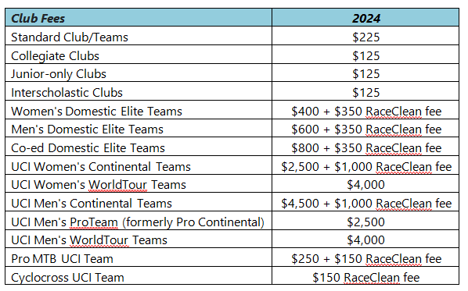

Slide 18
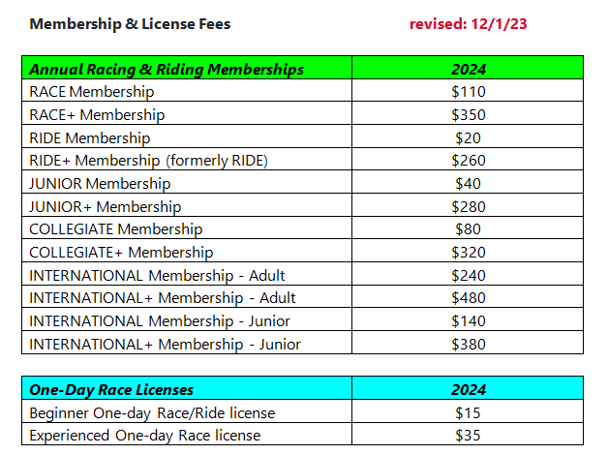

Slide 19
Officials Fees
Daily fee The organizer shall pay licensed officials a daily fee based on the race category. The fees are based on the highest race category for that day, plus the cost of reasonable and necessary travelThe race day is considered to be one hour before the first race starts until one-half hour after the last race finishes.
For any race that goes over 9 hours, officials will be paid for the time over 9 hours at a rate of $20 per hour, paid in increments every 15 minutes.
Round trip transportation from the official's home and during the race, or reimbursement for the transportation according to the published rates of USA Cycling
In one-day races that take place during the lunch/dinner
hour, either provifd lunch/dinner or $15 additional

Slide 20
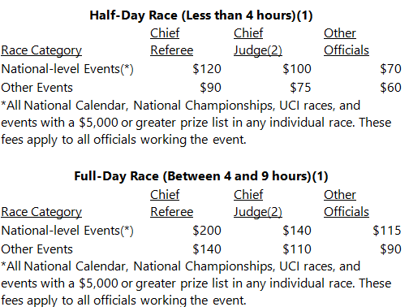

Slide 21
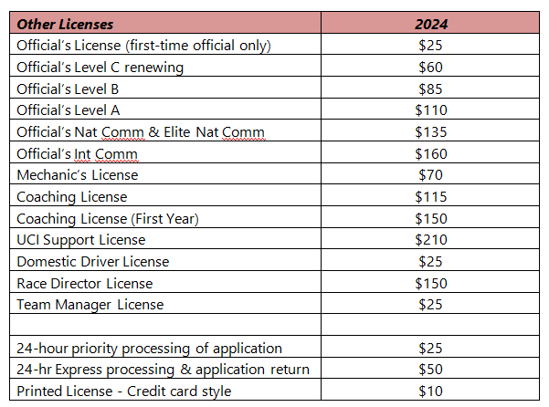

Slide 22
Important Rule Changes for 2024
For a complete list of changes and explanations,
see the rulebook page at usacycling.org

Slide 23
ICA EQUIPMENT –Available for all Illinois USAC registered clubs to use but advanced notice is REQUIRED!
Race Radios
10x10’ Tent with Tie Down straps and stakes
Generator
Extension Cords
Power Strips
Race Clipboards for Registration lists and #’s
Laptop
Registration & Results Program provided by Jason Knauff
Printer (Race must provide paper)
FinishLynx Camera - Camera Operator must be hired to work this equipment as additional training is required for use.

Slide 24

Questions?

Slide 25
Let’s get racing!!!!!!

